Slide 1

NVKMC Youths and Young Adults

Slide 2
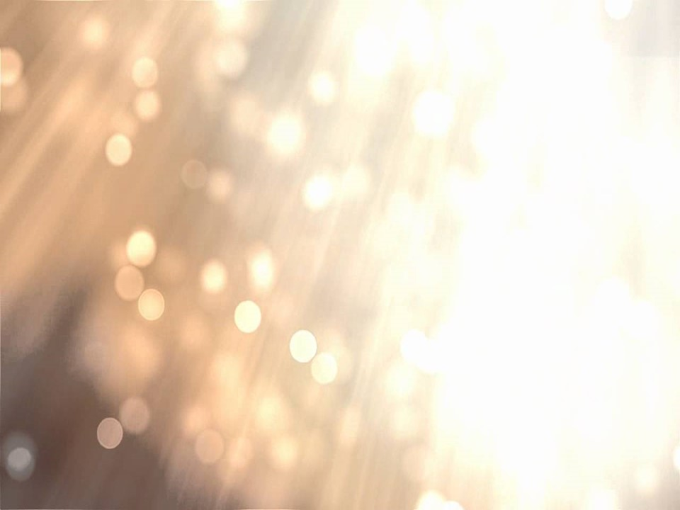
Praise:
Call to Worship
Apostle’s Creed
Sermon:
Offering
Prayer
Announcement
Lord’s Prayer

Slide 3
.
[]

Slide 4
Apostle’s Creed
I believe in God, the Father almighty,
creator of heaven and earth.

Slide 5
Apostle’s Creed
I believe in Jesus Christ,
his only Son, our Lord,

Slide 6
Apostle’s Creed
who was conceived
by the power of the Holy Spirit
born of the virgin Mary,

Slide 7
Apostle’s Creed
suffered under Pontius Pilate,
was crucified, died, and was buried;
he descended to the dead.

Slide 8
Apostle’s Creed
On the third day he rose again,
he ascended into heaven,
is seated at the right hand of the Father.

Slide 9
Apostle’s Creed
And will come again
to judge the living and the dead.

Slide 10
Apostle’s Creed
I believe in the Holy Spirit,
the holy catholic Church,

Slide 11
Apostle’s Creed
the communion of saints,
the forgiveness of sins,

Slide 12
Apostle’s Creed
the resurrection of the body,
and the life everlasting.
Amen.

Slide 13
Lord’s Prayer
Our Father in heaven,
hallowed be your name.

Slide 14
Lord’s Prayer
Your kingdom come,
your will be done,
on earth as it is in heaven.

Slide 15
Lord’s Prayer
Give us this day our daily bread,
and forgive us our debts,
as we also have forgiven our debtors.

Slide 16
Lord’s Prayer
And lead us not into temptation,
but deliver us from evil.

Slide 17
Lord’s Prayer
For yours is the kingdom
and the power and the glory, forever.
Amen.

Slide 18
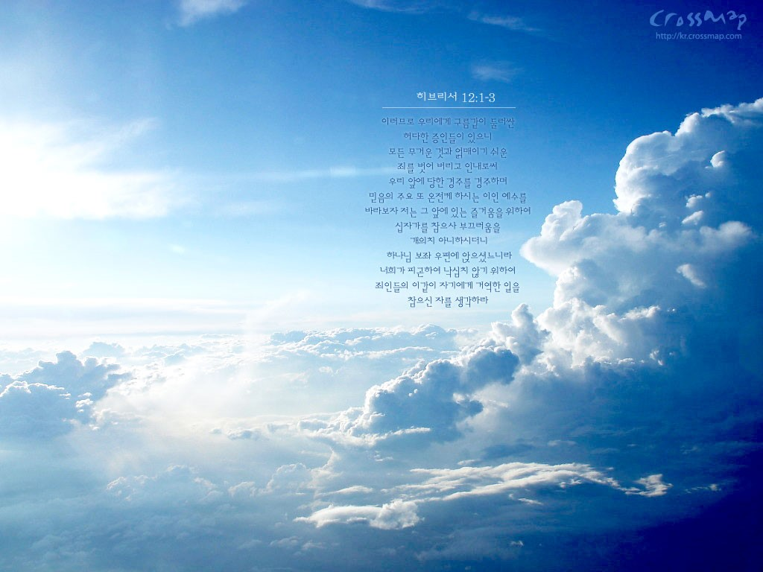
나는 전능하신
아버지 하나님,
천지의 창조주를 믿습니다.
I believe in God,
the Father almighty,
creator of heaven and earth.

Slide 19
나는 그의 유일하신 아들,
우리 주 예수 그리스도를 믿습니다.
I believe in Jesus Christ,
his only Son, our Lord,

Slide 20
그는 성령으로 잉태되어
동정녀 마리아에게서
나시고,
who was conceived by
the power of the Holy Spirit
born of the virgin Mary,

Slide 21
본디오 빌라도에게
고난을 받아
십자가에 못박혀 죽으시고,
suffered under Pontius Pilate
was crucified, died,
and was buried;

Slide 22
장사된 지 사흘 만에
죽은 자 가운데서
다시 살아나셨으며,
he descended to the dead.
On the third day
he rose again,

Slide 23
하늘에 오르시어
전능하신 아버지 하나님
우편에 앉아 계시다가,
he ascended into heaven,
is seated at the right hand
of the Father.

Slide 24
거기로부터
살아 있는 자와 죽은 자를
심판하러 오십니다.
And will come again
to judge the living
and the dead.

Slide 25
나는 성령을 믿으며,
거룩한 공교회와
성도의 교제와
I believe in the Holy Spirit,
the holy catholic Church,
the communion of saints,

Slide 26
죄를 용서받는 것과
몸의 부활과 영생을
믿습니다. 아멘.
the forgiveness of sins,
the resurrection of the body,
and the life everlasting.
Amen.

Slide 27
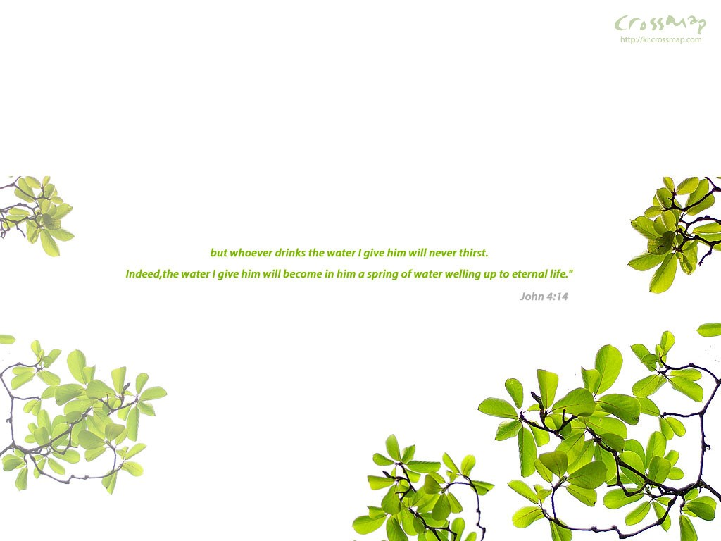
하늘에 계신 우리 아버지,
아버지의 이름을
거룩하게 하시며
Our Father in heaven,
hallowed be your name.

Slide 28
아버지의 나라가
오게 하시며,
Your kingdom come,

Slide 29
아버지의 뜻이
하늘에서와 같이 땅에서도 이루어지게 하소서.
your will be done,
on earth as it is in heaven.

Slide 30
오늘 우리에게
일용할 양식을 주시고,
Give us this day
our daily bread,

Slide 31
우리가 우리에게
잘못한 사람을
용서하여 준 것 같이
and forgive us our debts,

Slide 32
우리 죄를
용서하여 주시고,
as we also
have forgiven our debtors.

Slide 33
우리를 시험에 빠지지
않게 하시고,
악에서 구하소서,
And lead us
not into temptation,
but deliver us from evil.

Slide 34
나라와 권능과 영광이
영원히 아버지의 것입니다.
아멘.
For yours is the kingdom
and the power
and the glory, forever.
Amen.

Slide 35
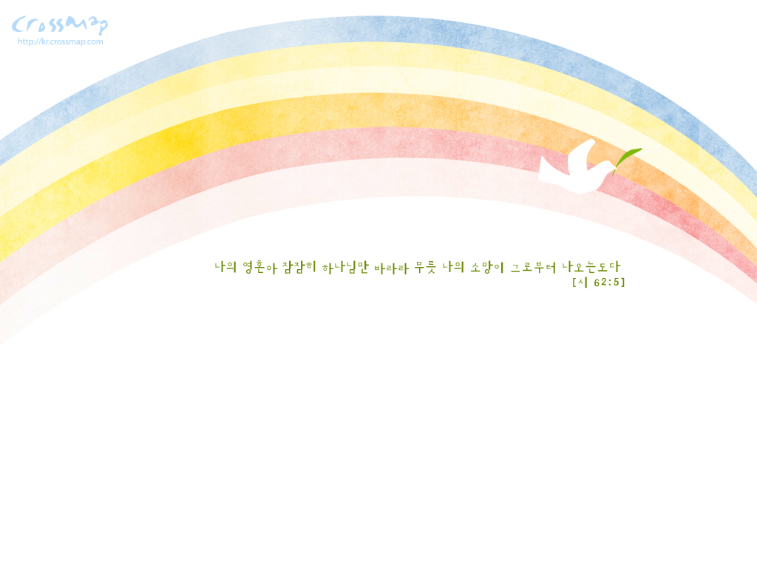
예수님 때문에 행복합니다!
We are happy because of Jesus Christ!

Slide 36


Slide 37
